Slide 1
Dealing with People You Can't Stand
Phil Pfeiffer
Fall 2014
based in large part on slides by Brinkman and Kirschner, others

Slide 2
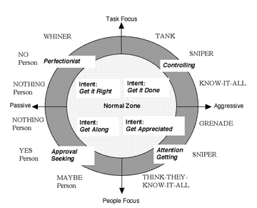
Assumption: We Start Here

Slide 3
Comparison with Getting Past No
Parallels: both focus on mutual problem solving
Distinction: People focuses more on personality
Ury | Brinkman and Kirschner
Go to the balcony | Backtrack (i.e., request restatement)
Step to their side | Blend
Step to their side | Identify positive intent
Step to their side | Ask clarifying questions
Reframe | Redirect
Reframe | Assume positive intent
Reframe | Appreciate criticism
"Step to their side" precedes reframing | Blending precedes redirecting

Slide 4
Blending
A prerequisite for effective communication
▪ no one cooperates with anyone who seems
to be against them.
Seek first to understand, then to be understood
Seek understanding on emotional and intellectual levels
Includes nonverbal communication
▪ Mirroring - but not aping - posture, facial expressions, degree of animation,
volume and speed of speech
▪ Exception: don't mirror aggressive behavior

Slide 5
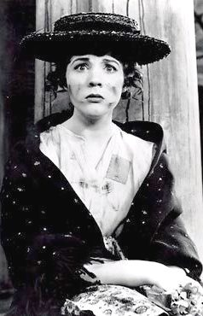
Focusing on Positive Intent
Assume difficult people have it
▪ Even if intent unclear,
make something up
▪ Leverage "Pygmalion effect"
Playing to positive intent
▪ get it done -
be brief, to the point
▪ get it right -
focus on detail
▪ get along -
be friendly, considerate
▪ get appreciation -
show enthusiasm

Slide 6
Guidelines for Speaking
Monitor your tone of voice
  Apologize, as needed, for getting this wrong
State your positive intent
Tactfully interrupt interruptions
Tell your truth
  Use "I" language
  Be specific about problem behavior
  Show them how their behavior is self-defeating
  Suggest new behaviors or options
Do last two idea sound familiar (i.e., Ury)?

Slide 7
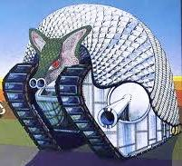
Tanks
Tanks attack those they see as
problems.
  Intent: press on towards goal
  No personal intent
Natural but poor responses
  Counterattack (danger: further escalation)
  Defend (ineffective: tank wants results)
  Shut down (ineffective: suggests your culpability)
Effective response:
  Seek to command respect
  Show assertiveness without aggressiveness

Slide 8
Action Plan for Tanks
If you're right
  Hold your ground; maintain self-control
  Interrupt attack - e.g., by repeating tank's name
  Backtrack to main point
  Aim for bottom line and state point - quickly
  Aim for peace with honor
    Allow tank to save face
    Assign time and conditions for last word
    Allow for parting shot
If you're wrong
  Admit to your mistake.
  State briefly what you’ve learned.
  State how you'll prevent mistake in future.
  Move on - don't grovel

Slide 9
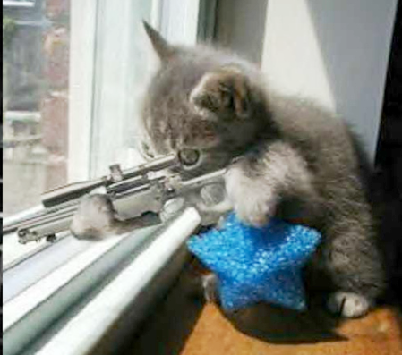
Snipers
M.O.:
  nasty remarks in passing,
  often passed off as humor
Motivations:
  Grudges
  Undermining others
  Getting attention
Avoid natural responses
  Lashing out
  Running away
  Teasing back
Effective response:
  Facing behavior calmly, rationally
  Exposing it for what it is

Slide 10
Action Plan for Friendly Sniping
Stay calm. Focus on sniper, not yourself.
Laugh off occasional sniping
Otherwise
  Call attention to behavior in private
  Express distate honestly: i.e.,
    It makes you want to avoid them, but
    Would rather not do this
  Reinforce positive humor

Slide 11
Action Plan for Malicious Sniping
Stay calm. Focus on sniper, not yourself.
Backtrack what was said
Use clarifying questions to expose behavior
  Intent: "is that what you really meant?"
  Relevancy: "what does that have to do with this?"
Stay neutral; play innocent
Respond to sniper's next move
  If backing off, do nothing
  If continued sniping, continue backtracking
  If aggression (e.g., tank), switch strategy
If grudge involved, address in private
Suggest a civil future

Slide 12
Special Case: Third Party Sniping
Sometimes informants are snipers in disguise.
  “Did you hear what so-and-so said about you?”
Expose behavior using searchlight questions:
  1. “Does so-and-so know you're telling me this?”
  2. “Let’s go talk to so-and-so.”
  3. “Who told you that?”

Slide 13

Know-it-Alls
Knowledgeable, highly competent,
highly assertive, outspoken
Intent: work in way they've
predetermined as best.
  Can be very controlling,
  Intolerant of correction
  and contradiction.
  Will take up others’ time talking
  Don't want to waste their own time by listening to others
  See disagreement as challenge to authority, knowledge; being wrong as being humiliated

Slide 14
Action Plan
Adjust your attitude
  Avoid resentment: it will build into an argument.
  Learn to treat know-it-all with compassion
    Behavior due to uncertainty, insecurity, unhappiness
Seek to open other's mind to new idea
  Know your stuff. Be prepared to state it concisely, clearly
  Backtrack respectfully, patiently
  Blend with concerns
  Present views indirectly
    Treat ideas as hypotheticals ("maybe", "perhaps")
    Use plural pronouns like "we", "us"
    Use questions instead of statements
Allow them to mentor you

Slide 15
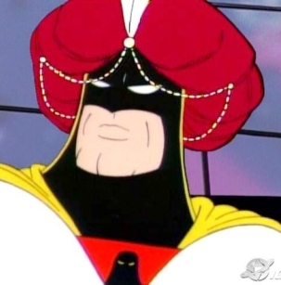
They-Think-They-Know-It-Alls
M.O.: gaining attention
  Knack of learning just enough to
  sound knowledgeable
  Tendency to push their way into
  conversations, even if unwanted
  Given to exaggeration, repetition
Action plan
  Adjust attitude; start from position of compassion
  Backtrack comments in good faith
    Show enthusiasm; acknowledge positive intent
  Ask for specifics - but innocently. Be careful with nonverbals
  Use "I" messages to introduce reality into dialogue
  Allow person to save face - e.g., "maybe you haven't read that?", "thanks for helping me to remember that"
  Break cycle: appreciate where due; confront gently where not

Slide 16

Grenades
Respond to feeling unappreciated
with temper tantrum
Ineffective strategies
  Blow up right back
  Withdraw to safe distance
Action plan
  Forgive the temporary insanity
  Take control at start of blow-up
    Get their attention by repeating name, "sir", "ma'am"
      May need to be loud without being unfriendly
    "Aim for the heart" - respond directly to key concerns
    Talk the grenade down
    Put off meaningful talk for later, after grenade cools off
    Use talk to work to prevent more issues in future

Slide 17
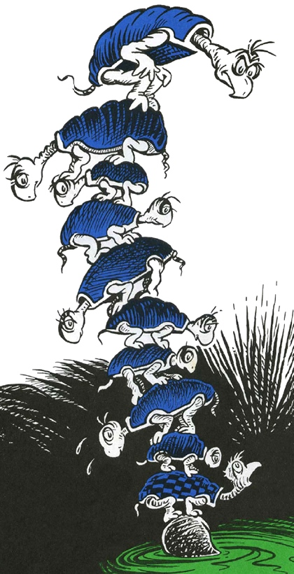
"Yes" People
Overcommit to promises they can't keep
Make excuses for not keeping promises - attribute concerns beyond control
Maintains pleasant outward appearance
Goals for addressing issues:
  Adjust attitude: show compassion for disorganization
  Focus on helping person develop time mgmt skills
  Make it safe for person to be honest
  Help person learn to be reliable

Slide 18
Action Plan for "Yes" People
Make it safe to be honest
  Keys: spending time; nonverbal blending; verbal reassurance
After acquiring trust, talk honestly
  Hear person out
  Express appreciation for honest communication
  Help person learn to plan
    Focus on strategies for overcoming mistakes
  Ensure commitment - e.g.,
    Ask for word of honor.
    Ask for verbal or written summary
    Create an unusual deadline.
    Describe the negative consequences.
  Strengthen relationship

Slide 19
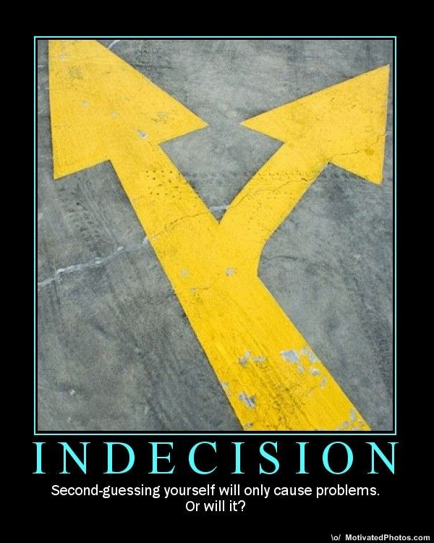
"Maybe" People
Paralyzed by potential downsides of decisions
Action plan
  Establish and maintain comfort zone
  Surface conflicts, clarify options
  Teach system for making decisions
    e.g.: plusses/ minuses in two columns
  Reassure
  Ensure follow-through
  Strength relationship

Slide 20
Nothing People

Slide 21
Nothing People
Qualities
  Withdraw to avoid conflict
    "Get along" person - upsetting others
    "Get it right" person - frustration with lack of perfectionism on others' part
  May be using silence to mask hostility
Approach
  Be patient - look and sound as if you have all the time in the world
  Be calm, relaxed
  Persuade person to talk

Slide 22
Action Plan for "Nothing" People
Leave enough time to work with person
Ask open-ended questions expectantly
  Ask how/ what questions
  Use non-verbal cues to request responses
  Repeat questions, leaving silence for answers
Lighten up conversation - use innocuous humor
Make guesses in face of continuing silence -
look for nonverbal cues
Depending on relationship, inform person of consequences of continuing non-responsiveness

Slide 23
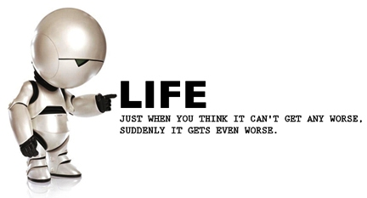
"No" People
Tend to anger or despair when others' shortcomings, weaknesses, and failings preclude perfection
Avoid disappointment by not getting hopes up
Most dangerous of difficult people: negativity
  undermines motivation, stifles development
  leads to depression and hopelessness in others.
Adjust attitude; find compassion
Try to move people from fault-finding to problem-solving

Slide 24
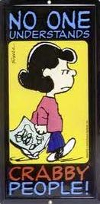
Action Plan
Go with the flow
  Avoid worst approach: "things aren't so bad"
Use as a resource
  Early warning system
  Someone to teach you to stay positive
Allow person to take time to decide
Try reverse psychology - bringing up negatives
  Could satisfy person
  Could cause person
  to negate your negatives
Acknowledge good intent

Slide 25
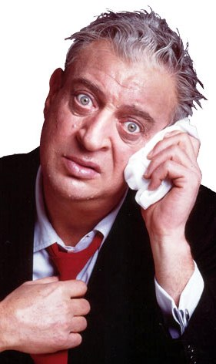
Whiners
A girl phoned me the
other day and said ‘Come
on over, there's nobody
home.’ I went over.
Nobody was home.
-- Rodney Dangerfield

Slide 26
Whiners and Complaining
Three types
  Helpful - leads to positive change
  Theraputic - addresses stress
  Chronic - the whiner
Like "no" person, with no plan for change
Strategies to avoid
  Agreeing or disagreeing with complaints
  Attempting to solve problems
  Ask why the person is complaining
Strategies to pursue
  Use patience and compassion
  Commit to long-term improvement
  Help partner with person to find solutions - or get away

Slide 27
Action Plan for Whiners
Listen for main points with paper and pen in hand
Tactfully interrupt - ask for specifics
  If not forthcoming now, request another hearing at later time, with details
Shift focus to solutions
  Ask "What do you want?"
  If wants unrealistic, do reality check: state facts, then ask what person wants in view of facts.
Show them the future
  If you're the problem, keep person informed of progress
  Otherwise, consider offering to facilitate
If talking isn't helping, draw the line

Slide 28
Advice for Applying These Steps
Make it a goal to become an effective communicator
  Study, practice these techniques
Team with a person who's as eager to learn as you
  Practice weekly
Count your blessings
If you have the luxury to read this book, you're already better off than perhaps 80% of the earth's population, in way that you may sometimes take for granted. You probably have a roof over your head, sufficient food, people you care about, and some that care about you. Life is difficult, and there's enough hardship as it is, without filling yourself with negativity. -- Brinkman and Kirschner

Slide 29
Advice for Changing Reactions
Decide what you want
Find a time or place in your life where using that attitude comes naturally
Find and emulate a model
Make it a habit to positively replay the past and preplay the future

Slide 30
Disassociation Techniques for Unpleasant Events, Difficult People
Compare difficulties with more difficult times in your life or more difficult issues
Project yourself to a time when difficulties won't matter
Mentally edit a memory like it was a film, reducing it
Become impartial and dispassionate (takes self-discipline)
Reframe meaning of experience as a positive or an opportunity

Slide 31
Changing How You Talk to Yourself
"I go for what I want, and I want what I get."
"Somewhere in this experience is an opportunity."
"Any experience I can learn from is a good one."
"I can be flexible."
"I know that anything is possible."
"Oh, well - my opinion won't change anything."
"All things must pass."
"This used to bother me. It no longer does"
"I will wait and trust."

